Slide 1



DATA FUSION AND MACHINE LEARNING II:
Convolutional Neural Networks (CNNs)
^{DÉBORA CORRÊA and} ^{AYHAM ZAITOUNY}
^{30 OCT 2018}

Slide 2
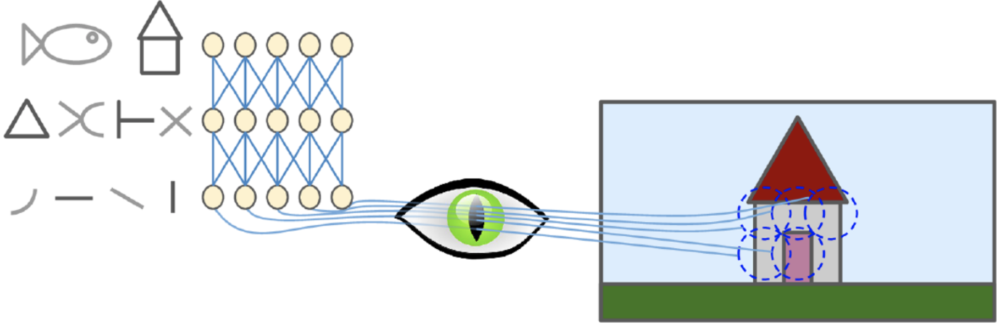
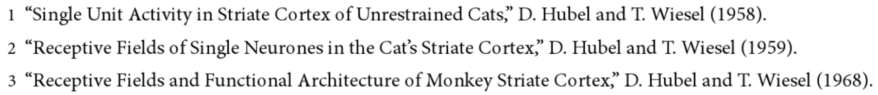
^{CNN - MOTIVATION}
Insights on the structure of the visual cortex^{1,2,3}:
Neurons respond to a small local receptive field: they react to a visual stimuli placed in a small region of the visual field.
Their receptive fields can overlap, and the whole visual field arises from the combination of individual local fields.
Idea that higher-level neurons use the neighboring of lower-level neurons, forming more complex patterns by combining lower-level patterns.
Source: Hands on Machine Learning with Scikit-Learn and TensorFlow, Cap. 13.

Slide 3
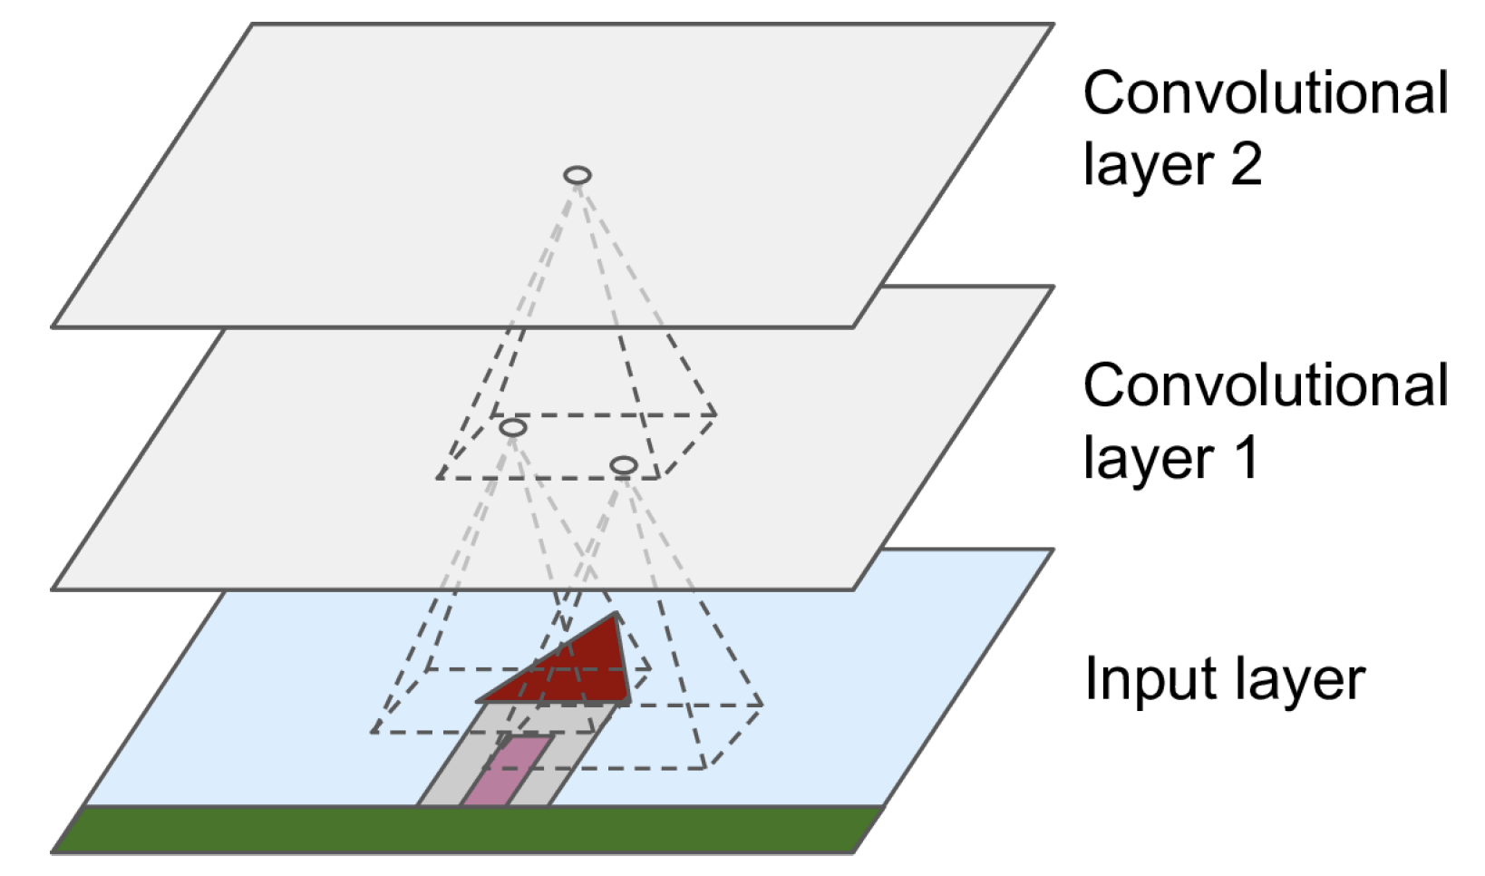
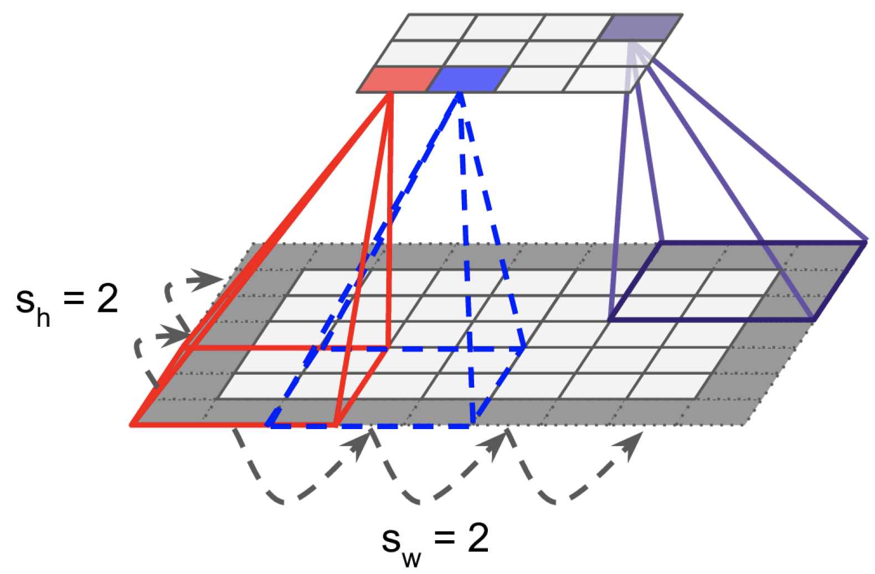
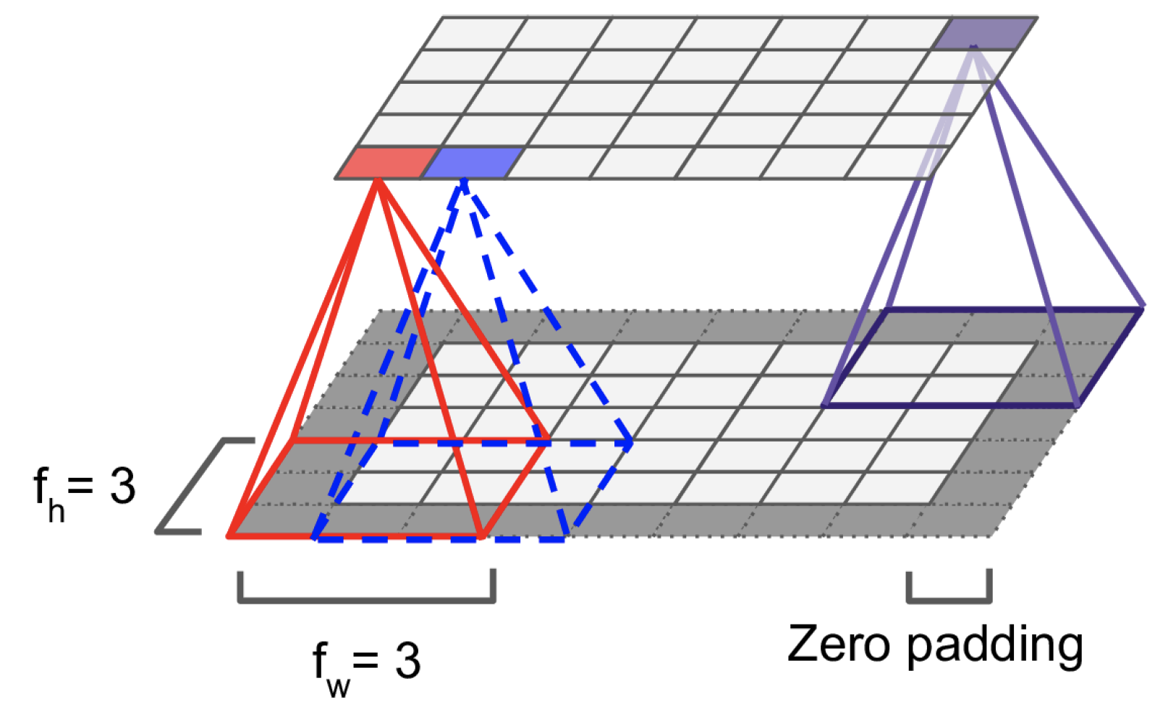
^{CONVOLUTIONAL LAYERS}
Each neuron layer is now 2D
Neurons in the first convolutional layer are connected only to a small rectangle of pixels representing their receptive fields.
Each neuron in subsequent layers is connected to neurons located in their receptive field.
stride is used to generate
smaller layers.
f_{h} and f_{w} define the height and width of the receptive field.
Source: Hands on Machine Learning with Scikit-Learn and TensorFlow, Cap. 13.

Slide 4
^{CONVOLUTION}
Important operation in image processing.
A (small) kernel matrix is applied to the input image in order to get
a transformed image according to a specific task.
Input matrix
Output matrix
95 | 101 | 98 | 102 | 97
96 | 100 | 99 | 101 | 114
99 | 98 | 99 | 99 | 87
94 | 98 | 100 | 102 | 94
89 | 91 | 95 | 98 | 89
100 | 99 | 87 | 89 | 91
104 | 101 | 88 | 93 | 96
 | 106
Kernel matrix
0 | -1 | 0
-1 | 5 | -1
0 | -1 | 0
Multiplication of each element of the kernel with the corresponding element of the image matrix.
(95 * 0) + (101 * -1) + (98 * 0)
+ (96 * -1) + (100 * 5) + (99 * -1)
+ (99 * 0) + (98 * -1) + (99 * 0) = 106

Slide 5
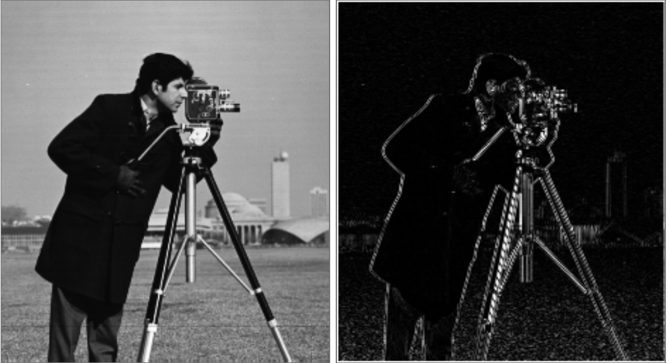
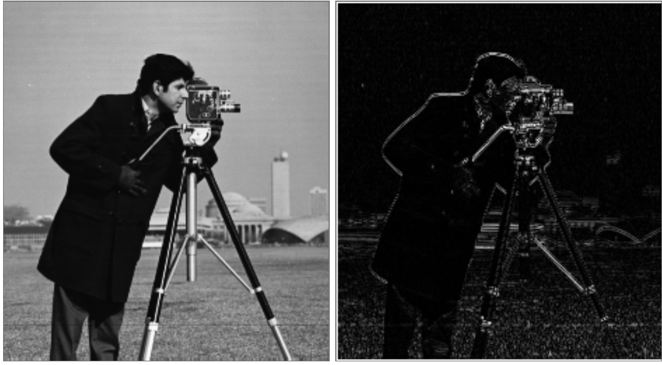
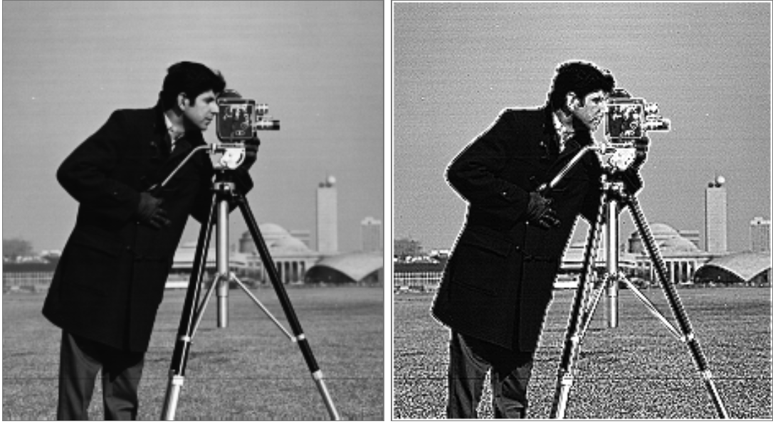
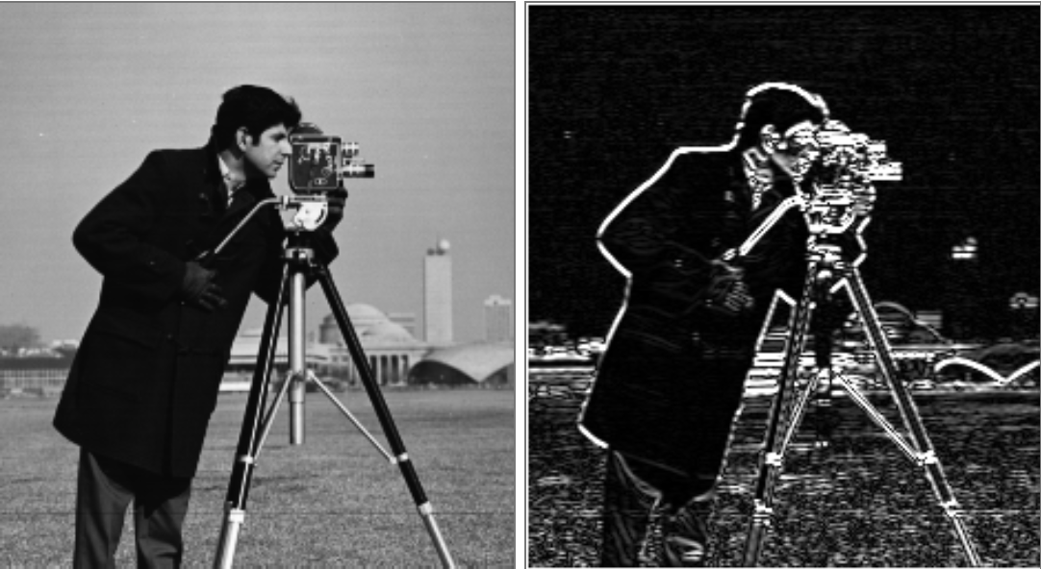
^{CONVOLUTION (Cont.)}
E.g., edge detection (horizontal, vertical), sharpen, blurring, etc.
0 | 0 | 0
-1 | 2 | -1
0 | 0 | 0
0 | -1 | 0
0 | 2 | 0
0 | -1 | 0
0 | -1 | 0
-1 | 5 | -1
0 | -1 | 0
1 | 2 | 1
0 | 0 | 0
-1 | -2 | -1

Slide 6

^{RGB IMAGES}
Source: http://machinelearninguru.com

Slide 7
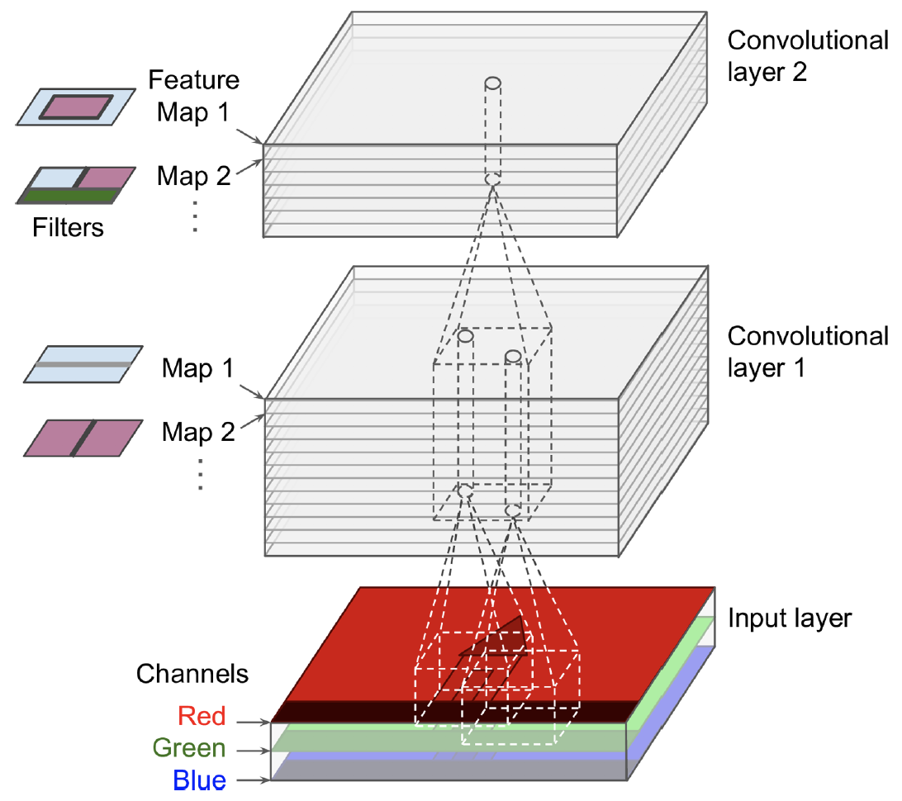
^{STACKING MULTIPLE FEATURE MAPS}
Kernel matrix
0 | -1 | 0
-1 | 5 | -1
0 | -1 | 0
bias
The weights of the kernel and the bias of each feature map are trained with the back-propagation algorithm.
A feature map share
the same weights and bias.
An activation function is applied
after each convolutional layer.
Source: Hands on Machine Learning with Scikit-Learn and TensorFlow, Cap. 13.

Slide 8
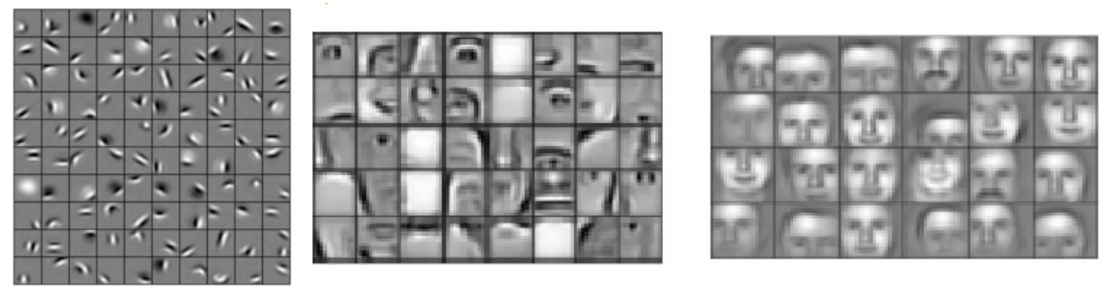
^{CNN - INTUITION}
Source: https://devblogs.nvidia.com/deep-learning-nutshell-core-concepts/

Slide 9
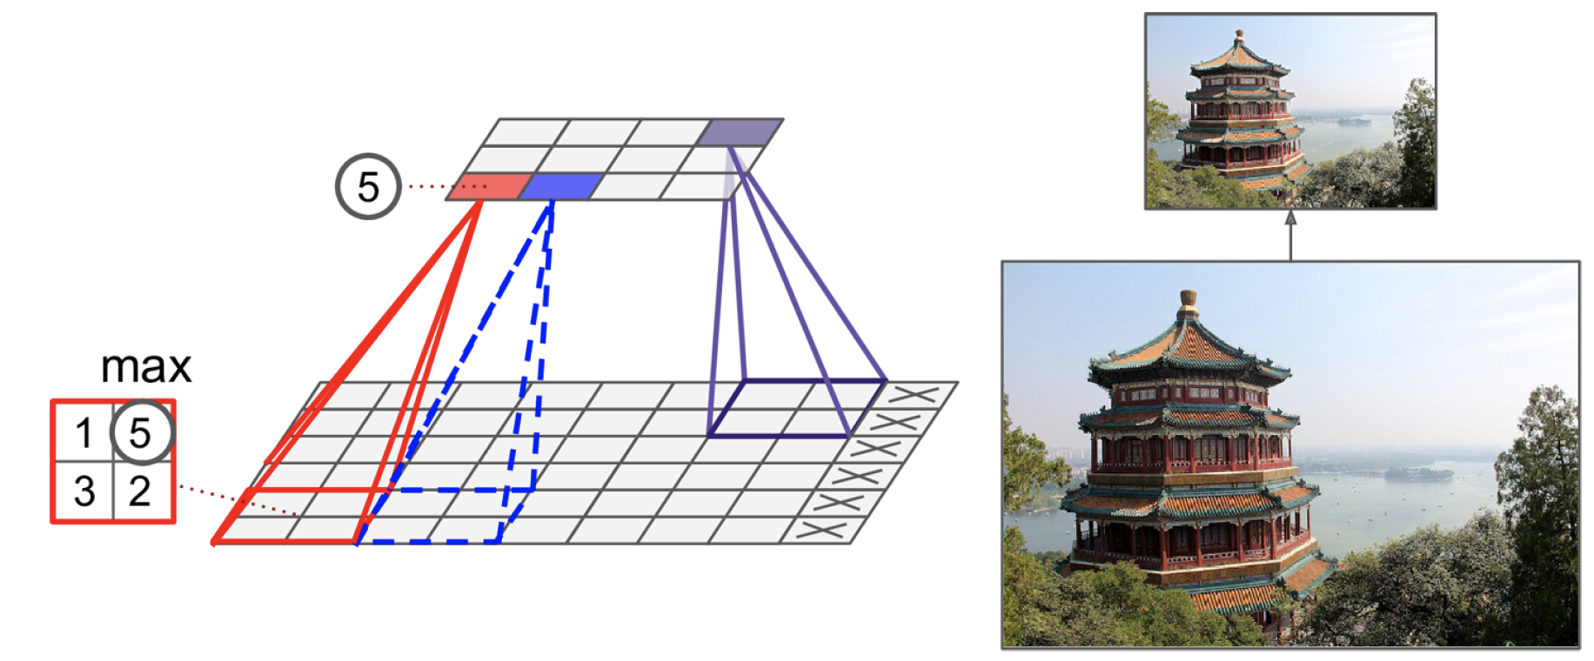
^{POOLING LAYER}
Objective: subsample the output of a layers.
Aggregation function, e.g., mean or max.
No weights, but requires the definition of size, stride, padding.
Source: Hands on Machine Learning with Scikit-Learn and TensorFlow, Cap. 13.

Slide 10
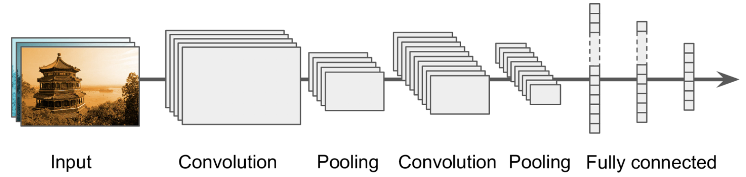
^{CNN ARCHITECTURE}
The conventional convolutional neural network is formed by convolutional layers, pooling layers and fully connected layers (with activation functions).
Idea: Generate feature maps that contain relevant (discriminative)
and compacted high-level features about the input image.
Final layer outputs the prediction of the class.

Slide 11
^{CNN vs Deep MLPs}
CNNs propose partially connected layers:
As all neurons in a feature map share the same weights and bias, CNN models significantly reduces the number of parameters of the model.
E.g., consider 100 x 100 images -> 10,000 pixels. A first MLP layer with 1,000 neurons (quite limited) requires 10 million parameters (just the first layer!).
Location and rotation invariance
CNNs learns a pattern independently of its location and 2D rotation.
Transfer learning.

Slide 12
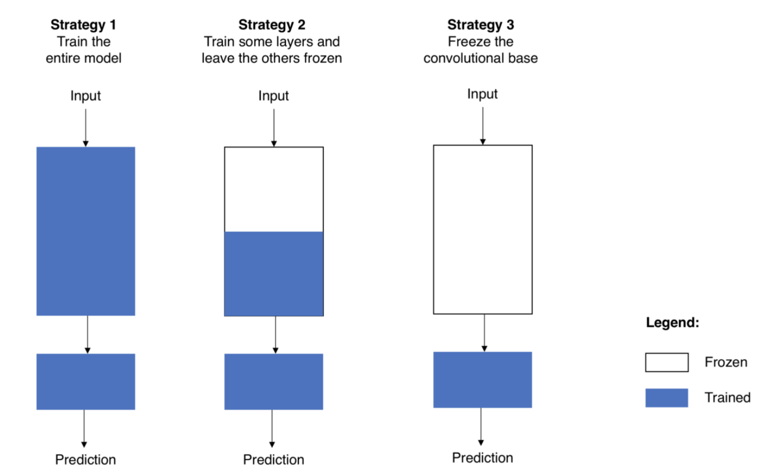
^{TRANSFER LEARNING}
Time efficient design of accurate models.
Idea: use of pre-trained models on tasks similar to what you want to solve.
Source: https://towardsdatascience.com/transfer-learning-from-pre-trained-models-f2393f124751

Slide 13
^{CNN – POWERFUL ARCHITECTURES}
Variants of the fundamental architecture used for transfer learning.
InceptionV4
https://arxiv.org/pdf/1602.07261.pdf
VGG
http://www.robots.ox.ac.uk/~vgg/practicals/cnn/index.html
GoogLeNet
https://ai.google/research/pubs/pub43022
ResNet
https://www.cv-foundation.org/openaccess/content_cvpr_2016/html/He_Deep_Residual_Learning_CVPR_2016_paper.html

